Slide 1

NYC Flight Services 2013

Slide 2
Team Info
Shankar Raju Sriramraj
Vinoo Subramaniam S K
Shyam Kumar Patibandla
Rajarathnam Balakrishnan
Domain – Airlines
Project- Analyze NYC-Flight data

Slide 3
Introduction
Analyzed dataset on flights departing from New york, USA to different locations for the year 2013.
Dataset is preprocessed before getting started.
Explored the data to answer many business questions like below.
Busiest route / Busiest airlines
Best flight to travel on each month
Does Volume of flights and delay are related?
Best time of the day to travel

Slide 4
Dataset Description
Dataset contains information about all flights departed from below NYC airports FY2013.
John F. Kennedy International Airport
Newark Liberty Airport
LaGuardia Airport
Total destination = 105
Total flights = 336,766 flights
Total flight Carriers = 16
NaN’s are present in few columns.

Slide 5
Data Preprocessing
Replaced null values in dataset with appropriate columns data.
Converted time given in departure and arrival columns to standard timestamp format.
Scheduled departure: 2013-01-01 05:17:00
Expanded airport abbreviation to full name.
JFK - John F. Kennedy International Airport
Expanded carrier abbreviation to full name.
AA- American Airlines
Delayed Buffer time = 10 mins

Slide 6
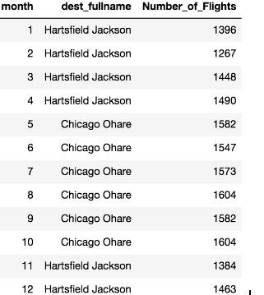
Maximum flights to destination
Approach
Group by “month and dest” and then find the count of flights
Sort the above result based on size and assign it to a temp DF
Group the temp DF (created in previous step) by month and taking the first record from each group
Findings
Jan month max flights
Hartsfield Jackson(ATL) = 1,396
Bonus Question
Total number of flights to ATL = 17,215

Slide 7
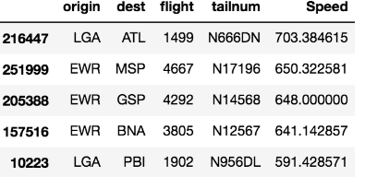
Top 5 faster flights
Approach
Divided distance taken for each flight by the air time.
Sorted faster flights in descending and printed top 5 faster flights
Findings
Fastest flight NYC 2013
Flight 1499(N666DN)=703 miles/hr
Note:
We can further obtain knots by
Multiplying miles/hr *0.868976

Slide 8
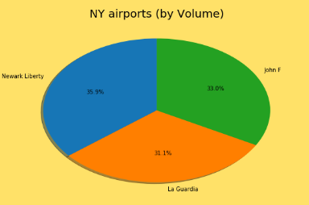
Volume of Flights from NYC airports
Approach
We have grouped by origin and taken count of flights from each origin.
Then we have divided the count by total flights and finally multiplied by 100 to get Percentage.
Findings
Newark Liberty (EWR) 35.9%
John.F.Kennedy (JFK) 33.0%
La Guardia (LGA) 31.1%

Slide 9
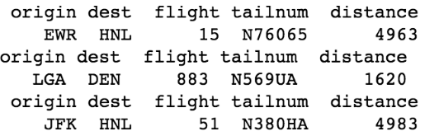
Long travelled flights from NYC airport
Approach
Find maximum distance travelled for each origin airport
Then get the flight details for the maximum speed trip for each origin
Findings
Longest distance from origin
EWR = 4,963 miles
LGA = 1,620 miles
JFK = 4,983 miles

Slide 10
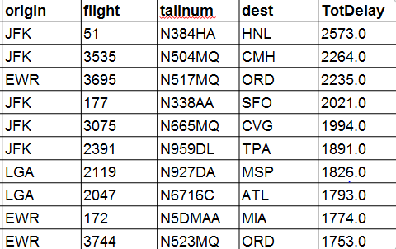
Top 10 most delayed flights
Approach
We have computed total delay by summing up arr and dep delays and sorted the values in descending order.
We have taken top 10 delayed flight information
Findings
Most delayed (in mins)
Flight(N384HA)-2573

Slide 11
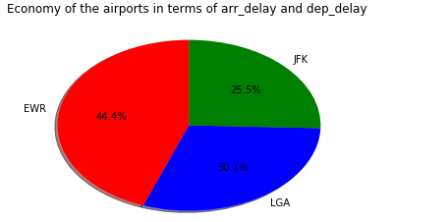
NYC Airport with less delay
Analysis
We have framed total_Delay by summing up arr_Delays and dep_delays
Then we have grouped by each origin and taken sum of total delays
Findings
Best Airport with less delays
JFK 25.5%

Slide 12
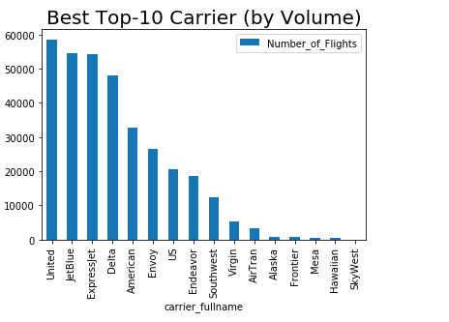
Busiest airlines
Approach
Grouping the flights dataframe by "carrier" and then find the size of each group
Sort the above result based on size and assign it to a temp DF
Plot the above DF in bar chart
Findings
Hawaiian, SkyWest are
having less footprint
United , JetBlue and
Express Jet are busiest carriers

Slide 13
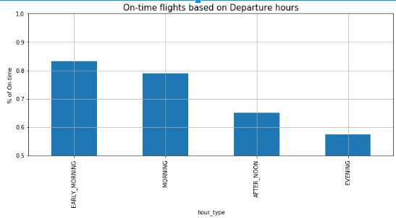
Ontime flights - Morning / Evening?
Approach
We have divided the day into 4 parts and calculated the count of flights for each part
We have projected the count in bar chart as below
Four parts of the day
Early morning = 12 AM to 6 AM
Morning = 6 AM to 12 PM
AfterNoon = 12 PM to 6 PM
Evening = 6 PM to 12 AM
Findings
Early morning has more number
flights reaches on time

Slide 14
Monthly Volume VS Delay plot
Approach
Group the data based on scheduled departure 'month'
Find departure delay, arrival delay and overall delay for each month
Create an subplot axis(ax1) and plot the delays in that axis
Create another axis(ax2) by copying the x-axis of ax1
Plot "Number of flights" in y-axis of ax2
Set appropriate xlim for both right and left x-axis for readability
Findings
Approx same number of flights every month(25K - 28K flights)
June and July month has more delays [Summer vacation?]
December month has more delays [Weather related? ]

Slide 15
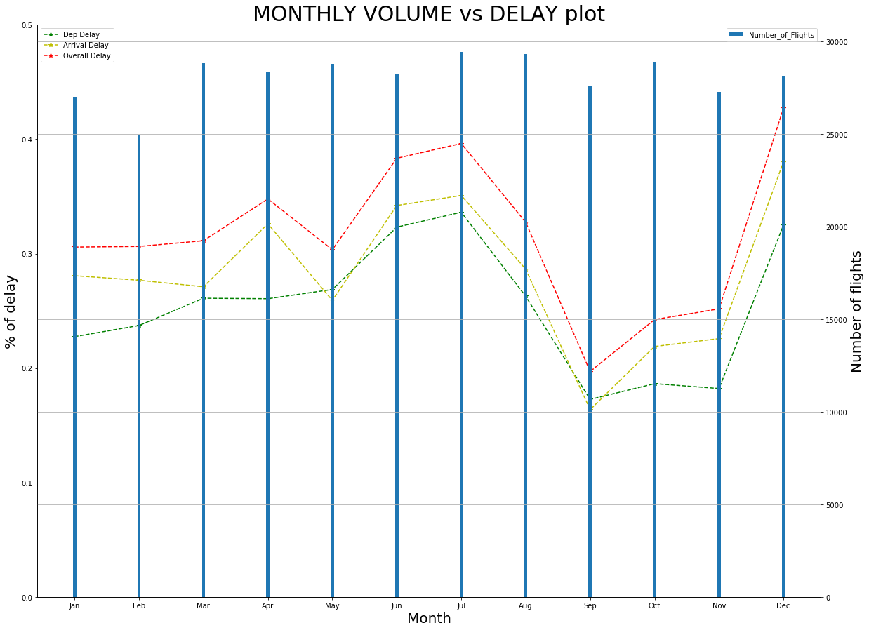

Slide 16
On time airlines in % for each month
Approach
% of on_time flights:Create pivot table with index = 'month' , columns = 'carrier' ,values = 'overall_ontime', agg_func = mean()
Number of on_time flights:Create another pivot table with index = 'month' , columns = 'carrier' ,values = 'overall_ontime', agg_func = sum()
To order the columns, drop the empty level
Get the "busy carriers - custom dict", a dictionary with carriers ranked based on number of flights flown in that year
Sort the pivot tables(step-1,2) columns based on "busy carriers - custom dict" from previous step
Expand months and carrier names for readability
Add additional column 'ALL_MONTH' for the whole year
Creating custom label for heatmap which contains both on_time "percentage and number_of_flights"
Set the x-axis tick labels at the top for readability
Generate the heatmap
Findings
Hawaiian airlines flights(to) reached 82% on time
In July month
Alaska airlines has 80% on-time flights [ # of flights: 50]
American airlines has 71% on-time arrival rate [# of flights: 2,071]

Slide 17
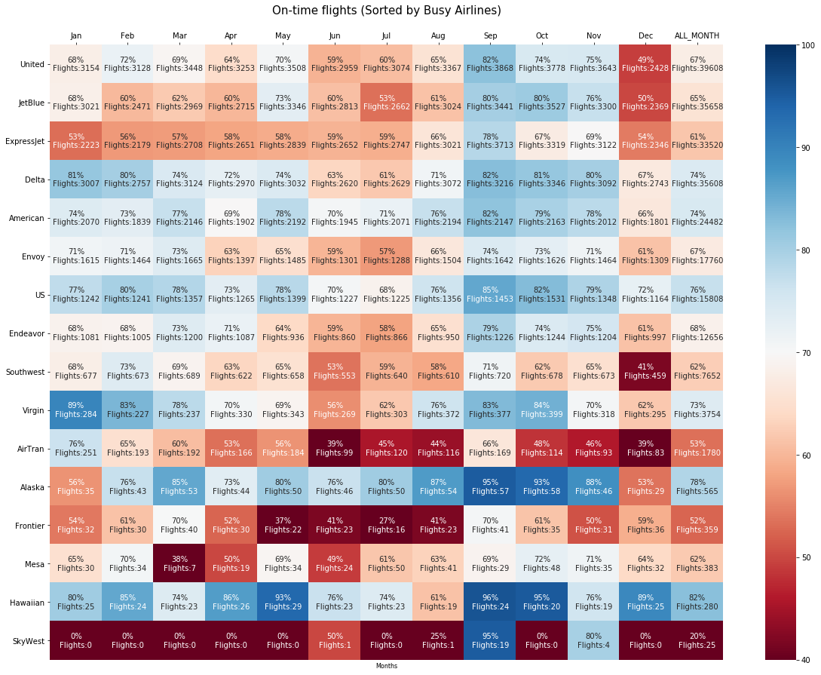

Slide 18


